Slide 1

William Stallings Computer Organization and Architecture 9th Edition
Notes:
Lecture slides prepared for “Computer Organization and Architecture”, 9/e, by William Stallings, Chapter 3 “A Top Level View of Computer Function and Interconnection”.

Slide 2
A Top-Level View of Computer Function and Interconnection
Notes:
At a top level, a computer consists of CPU (central processing unit), memory, and
I/O components, with one or more modules of each type. These components are
interconnected in some fashion to achieve the basic function of the computer, which
is to execute programs. Thus, at a top level, we can characterize a computer system
by describing (1) the external behavior of each component, that is, the data and
control signals that it exchanges with other components and (2) the interconnection
structure and the controls required to manage the use of the interconnection
structure.
This top-level view of structure and function is important because of its
explanatory power in understanding the nature of a computer. Equally important is
its use to understand the increasingly complex issues of performance evaluation. A
grasp of the top-level structure and function offers insight into system bottlenecks,
alternate pathways, the magnitude of system failures if a component fails, and the
ease of adding performance enhancements. In many cases, requirements for greater
system power and fail-safe capabilities are being met by changing the design rather
than merely increasing the speed and reliability of individual components.
This chapter focuses on the basic structures used for computer component
interconnection. As background, the chapter begins with a brief examination of the
basic components and their interface requirements. Then a functional overview is
provided. We are then prepared to examine the use of buses to interconnect system
components.

Slide 3
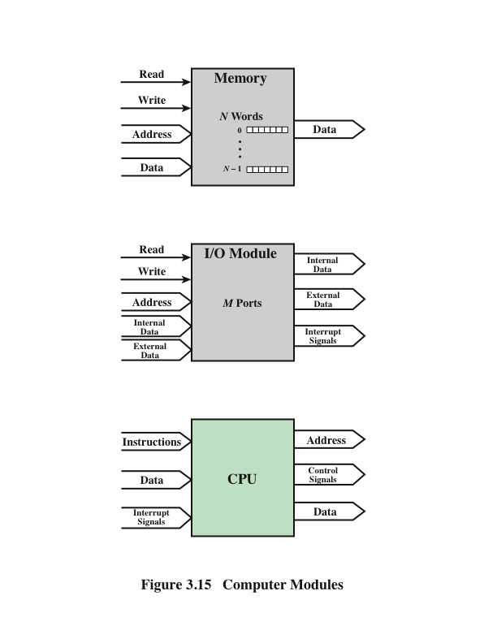
Computer Modules
Notes:
A computer consists of a set of components or modules of three basic types
(processor, memory, I/O) that communicate with each other. In effect, a computer is
a network of basic modules. Thus, there must be paths for connecting the modules.
The collection of paths connecting the various modules is called the interconnection
structure. The design of this structure will depend on the exchanges that
must be made among modules.
Figure 3.15 suggests the types of exchanges that are needed by indicating the
major forms of input and output for each module type:
• Memory: Typically, a memory module will consist of N words of equal length.
Each word is assigned a unique numerical address (0, 1, …, N - 1). A word of
data can be read from or written into the memory. The nature of the operation
is indicated by read and write control signals. The location for the operation is
specified by an address.
• I/O module: From an internal (to the computer system) point of view, I/O
is functionally similar to memory. There are two operations, read and write.
Further, an I/O module may control more than one external device. We can
refer to each of the interfaces to an external device as a port and give each
a unique address (e.g., 0, 1, …, M - 1). In addition, there are external data
paths for the input and output of data with an external device. Finally, an I/O
module may be able to send interrupt signals to the processor.
• Processor: The processor reads in instructions and data, writes out data after
processing, and uses control signals to control the overall operation of the
system. It also receives interrupt signals.

Slide 4
The interconnection structure must support the following types of transfers:
Memory to processor
Processor reads an instruction or a unit of data from memory
Processor to memory
Processor writes a unit of data to memory
I/O to processor
Processor reads data from an I/O device via an I/O module
Processor to I/O
Processor sends data to the I/O device
I/O to or from memory
An I/O module is allowed to exchange data directly with memory without going through the processor using direct memory access
Notes:
The preceding list defines the data to be exchanged. The interconnection
structure must support the following types of transfers:
• Memory to processor: The processor reads an instruction or a unit of data
from memory.
• Processor to memory: The processor writes a unit of data to memory.
• I/O to processor: The processor reads data from an I/O device via an I/O
module.
• Processor to I/O: The processor sends data to the I/O device.
• I/O to or from memory: For these two cases, an I/O module is allowed to exchange
data directly with memory, without going through the processor, using
direct memory access.
Over the years, a number of interconnection structures have been tried. By
far the most common are (1) the bus and various multiple-bus structures, and (2)
point-to-point interconnection structures with packetized data transfer. We devote
the remainder of this chapter for a discussion of these structures.

Slide 5
Bus Interconnection
A communication pathway connecting two or more devices
Key characteristic is that it is a shared transmission medium
Signals transmitted by any one device are available for reception by all other devices attached to the bus
If two devices transmit during the same time period their signals will overlap and become garbled
Typically consists of multiple communication lines
Each line is capable of transmitting signals representing binary 1 and binary 0
Computer systems contain a number of different buses that provide pathways between components at various levels of the computer system hierarchy
System bus
A bus that connects major computer components (processor, memory, I/O)
The most common computer interconnection structures are based on the use of one or more system buses
Notes:
A bus is a communication pathway connecting two or more devices. A key characteristic
of a bus is that it is a shared transmission medium. Multiple devices connect
to the bus, and a signal transmitted by any one device is available for reception by
all other devices attached to the bus. If two devices transmit during the same time
period, their signals will overlap and become garbled. Thus, only one device at a
time can successfully transmit.
Typically, a bus consists of multiple communication pathways, or lines. Each
line is capable of transmitting signals representing binary 1 and binary 0. Over time,
a sequence of binary digits can be transmitted across a single line. Taken together,
several lines of a bus can be used to transmit binary digits simultaneously (in parallel).
For example, an 8-bit unit of data can be transmitted over eight bus lines.
Computer systems contain a number of different buses that provide pathways
between components at various levels of the computer system hierarchy. A bus that
connects major computer components (processor, memory, I/O) is called a system
bus. The most common computer interconnection structures are based on the use of
one or more system buses.

Slide 6
Data Bus
Data lines that provide a path for moving data among system modules
May consist of 32, 64, 128, or more separate lines
The number of lines is referred to as the width of the data bus
The number of lines determines how many bits can be transferred at a time
The width of the data bus
is a key factor in
determining overall
system performance
Notes:
A system bus consists, typically, of from about fifty to hundreds of separate lines.
The data lines provide a path for moving data among system modules. These
lines, collectively, are called the data bus. The data bus may consist of 32, 64, 128, or
even more separate lines, the number of lines being referred to as the width of the
data bus. Because each line can carry only 1 bit at a time, the number of lines determines
how many bits can be transferred at a time. The width of the data bus is a key
factor in determining overall system performance. For example, if the data bus is
32 bits wide and each instruction is 64 bits long, then the processor must access the
memory module twice during each instruction cycle.

Slide 7
Address Bus Control Bus
Used to designate the source or destination of the data on the data bus
If the processor wishes to read a word of data from memory it puts the address of the desired word on the address lines
Width determines the maximum possible memory capacity of the system
Also used to address I/O ports
The higher order bits are used to select a particular module on the bus and the lower order bits select a memory location or I/O port within the module
Used to control the access and the use of the data and address lines
Because the data and address lines are shared by all components there must be a means of controlling their use
Control signals transmit both command and timing information among system modules
Timing signals indicate the validity of data and address information
Command signals specify operations to be performed
Notes:
The address lines are used to designate the source or destination of the data on
the data bus. For example, if the processor wishes to read a word (8, 16, or 32 bits)
of data from memory, it puts the address of the desired word on the address lines.
Clearly, the width of the address bus determines the maximum possible memory
capacity of the system. Furthermore, the address lines are generally also used to
address I/O ports. Typically, the higher-order bits are used to select a particular
module on the bus, and the lower-order bits select a memory location or I/O port
within the module. For example, on an 8-bit address bus, address 01111111 and
below might reference locations in a memory module (module 0) with 128 words
of memory, and address 10000000 and above refer to devices attached to an I/O
module (module 1).
The control lines are used to control the access to and the use of the data and
address lines. Because the data and address lines are shared by all components,
there must be a means of controlling their use. Control signals transmit both command
and timing information among system modules. Timing signals indicate the
validity of data and address information. Command signals specify operations to be
performed. Typical control lines include:
• Memory write: causes data on the bus to be written into the addressed location
• Memory read: causes data from the addressed location to be placed on the
bus
• I/O write: causes data on the bus to be output to the addressed I/O port
• I/O read: causes data from the addressed I/O port to be placed on the bus
• Transfer ACK: indicates that data have been accepted from or placed on the
bus
• Bus request: indicates that a module needs to gain control of the bus
• Bus grant: indicates that a requesting module has been granted control of the
bus
• Interrupt request: indicates that an interrupt is pending
• Interrupt ACK: acknowledges that the pending interrupt has been recognized
• Clock: is used to synchronize operations
• Reset: initializes all modules

Slide 8
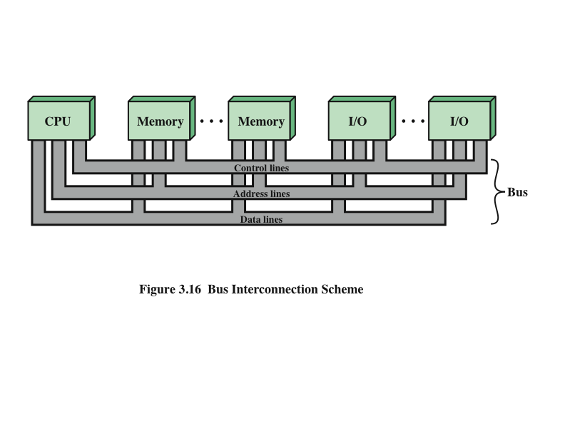
Bus Interconnection Scheme
Notes:
The operation of the bus is as follows. If one module wishes to send data to
another, it must do two things: (1) obtain the use of the bus, and (2) transfer data
via the bus. If one module wishes to request data from another module, it must (1)
obtain the use of the bus, and (2) transfer a request to the other module over the
appropriate control and address lines. It must then wait for that second module to
send the data.

Slide 9
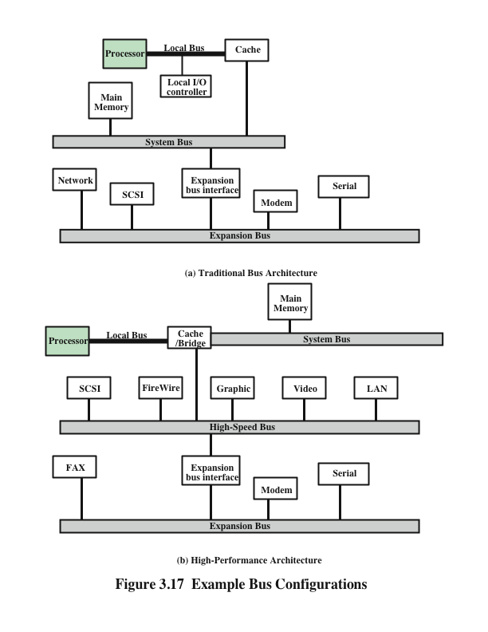
Bus
Configurations
Notes:
If a great number of devices are connected to the bus, performance will suffer.
There are two main causes:
1. In general, the more devices attached to the bus, the greater the bus length
and hence the greater the propagation delay. This delay determines the time
it takes for devices to coordinate the use of the bus. When control of the bus
passes from one device to another frequently, these propagation delays can
noticeably affect performance.
2. The bus may become a bottleneck as the aggregate data transfer demand
approaches the capacity of the bus. This problem can be countered to some
extent by increasing the data rate that the bus can carry and by using wider
buses (e.g., increasing the data bus from 32 to 64 bits). However, because the
data rates generated by attached devices (e.g., graphics and video controllers,
network interfaces) are growing rapidly, this is a race that a single bus is
ultimately destined to lose.
Accordingly, most bus-based computer systems use multiple buses, generally
laid out in a hierarchy. A typical traditional structure is shown in Figure 3.17a. There
is a local bus that connects the processor to a cache memory and that may support
one or more local devices. The cache memory controller connects the cache not only
to this local bus, but to a system bus to which are attached all of the main memory
modules. In contemporary systems, the cache is in the same chip as the processor, and
so an external bus or other interconnect scheme is not needed, although there may
also be an external cache. As will be discussed in Chapter 4, the use of a cache structure
insulates the processor from a requirement to access main memory frequently.
Hence, main memory can be moved off of the local bus onto a system bus. In this way,
I/O transfers to and from the main memory across the system bus do not interfere
with the processor’s activity.
It is possible to connect I/O controllers directly onto the system bus. A more
efficient solution is to make use of one or more expansion buses for this purpose.
An expansion bus interface buffers data transfers between the system bus and the
I/O controllers on the expansion bus. This arrangement allows the system to support
a wide variety of I/O devices and at the same time insulate memory-to-processor
traffic from I/O traffic.
Figure 3.17a shows some typical examples of I/O devices that might be attached
to the expansion bus. Network connections include local area networks (LANs)
such as a 10-Mbps Ethernet and connections to wide area networks (WANs) such as
a packet-switching network. SCSI (small computer system interface) is itself a type
of bus used to support local disk drives and other peripherals. A serial port could be
used to support a printer or scanner.
This traditional bus architecture is reasonably efficient but begins to break
down as higher and higher performance is seen in the I/O devices. In response to
these growing demands, a common approach taken by industry is to build a high-speed
bus that is closely integrated with the rest of the system, requiring only a
bridge between the processor’s bus and the high-speed bus. This arrangement is
sometimes known as a mezzanine architecture.
Figure 3.17b shows a typical realization of this approach. Again, there is a local
bus that connects the processor to a cache controller, which is in turn connected to
a system bus that supports main memory. The cache controller is integrated into a
bridge, or buffering device, that connects to the high-speed bus. This bus supports
connections to high-speed LANs, such as Fast Ethernet at 100 Mbps, video and
graphics workstation controllers, as well as interface controllers to local peripheral
buses, including SCSI and FireWire. The latter is a high-speed bus arrangement
specifically designed to support high-capacity I/O devices. Lower-speed devices are
still supported off an expansion bus, with an interface buffering traffic between the
expansion bus and the high-speed bus.
The advantage of this arrangement is that the high-speed bus brings high demand
devices into closer integration with the processor and at the same time is
independent of the processor. Thus, differences in processor and high-speed bus
speeds and signal line definitions are tolerated. Changes in processor architecture
do not affect the high-speed bus, and vice versa.

Slide 10
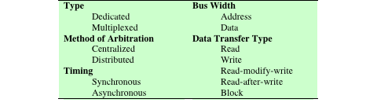
Elements of Bus Design
Notes:
Although a variety of different bus implementations exist, there are a few basic
parameters or design elements that serve to classify and differentiate buses. Table 3.2
lists key elements.
Bus Types: Bus lines can be separated into two generic types: dedicated and
multiplexed. A dedicated bus line is permanently assigned either to one function or
to a physical subset of computer components.
An example of functional dedication is the use of separate dedicated address
and data lines, which is common on many buses. However, it is not essential. For
example, address and data information may be transmitted over the same set of
lines using an Address Valid control line. At the beginning of a data transfer, the
address is placed on the bus and the Address Valid line is activated. At this point,
each module has a specified period of time to copy the address and determine if
it is the addressed module. The address is then removed from the bus, and the
same bus connections are used for the subsequent read or write data transfer. This
method of using the same lines for multiple purposes is known as time multiplexing.
The advantage of time multiplexing is the use of fewer lines, which saves space
and, usually, cost. The disadvantage is that more complex circuitry is needed within
each module. Also, there is a potential reduction in performance because certain
events that share the same lines cannot take place in parallel.
Physical dedication refers to the use of multiple buses, each of which connects
only a subset of modules. A typical example is the use of an I/O bus to interconnect
all I/O modules; this bus is then connected to the main bus through some type of I/O
adapter module. The potential advantage of physical dedication is high throughput,
because there is less bus contention. A disadvantage is the increased size and cost of
the system.
Method of arbitration: In all but the simplest systems, more than one module
may need control of the bus. For example, an I/O module may need to read or write
directly to memory, without sending the data to the processor. Because only one unit
at a time can successfully transmit over the bus, some method of arbitration is needed.
The various methods can be roughly classified as being either centralized arbitration
or distributed arbitration. In a centralized scheme, a single hardware device, referred
to as a bus controller or arbiter, is responsible for allocating time on the bus. The
device may be a separate module or part of the processor. In a distributed scheme,
there is no central controller. Rather, each module contains access control logic and
the modules act together to share the bus. With both methods of arbitration, the
purpose is to designate one device, either the processor or an I/O module, as master.
The master may then initiate a data transfer (e.g., read or write) with some other
device, which acts as slave for this particular exchange.
Timing: Timing refers to the way in which events are coordinated on the bus. Buses
use either synchronous timing or asynchronous timing.

Slide 11
Bus Design Elements | Description
Clock Speed | The frequency at which the bus operates, determining how many cycles per second it can complete. Measured in MHz or GHz, higher clock speeds result in faster data transfer rates, enhancing communication between components.
Bus Arbitration | The mechanism used to determine how multiple devices can access and share the bus without causing conflicts. Arbitration can be centralized, using a bus controller, or distributed. Effective arbitration is crucial for preventing data collisions and ensuring smooth communication.
Bus Topology | The physical layout and structure of the bus connections. In a Parallel Bus, multiple lines carry multiple bits simultaneously, which is faster but can be prone to interference over longer distances. A Serial Bus transmits data one bit at a time, which is slower for individual transfers but is more scalable for longer distances and easier to manage.

Slide 12
Bus Design Elements | Description
Bus width | The number of bits that can be transmitted simultaneously over the bus. A wider bus allows for greater data throughput, enabling more data to be transferred per clock cycle. Common bus widths are 8, 16, 32, 64, and 128 bits, directly impacting system performance
Data transfer Mode (timings) | Defines how data is transmitted on the bus. In Synchronous Mode, data transfer is synchronized with a clock signal, ensuring consistent timing. In Asynchronous Mode, data is transferred based on handshaking signals between devices, offering more flexibility in timing but requiring additional control signals.

Slide 13
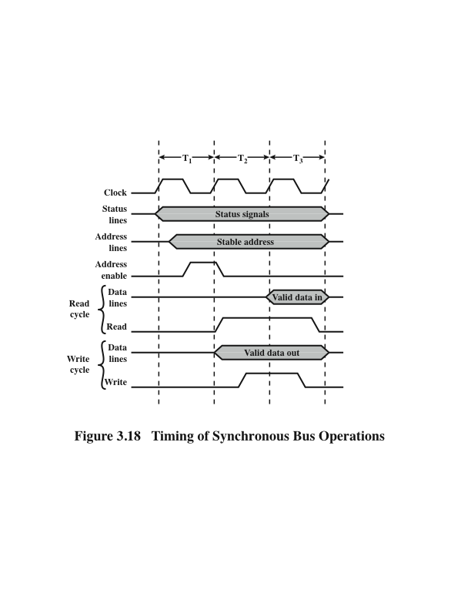
Timing of Synchronous Bus Operations
Notes:
With synchronous timing, the occurrence of events on the bus is determined
by a clock. The bus includes a clock line upon which a clock transmits a regular
sequence of alternating 1s and 0s of equal duration. A single 1–0 transmission is
referred to as a clock cycle or bus cycle and defines a time slot. All other devices on
the bus can read the clock line, and all events start at the beginning of a clock cycle.
Figure 3.18 shows a typical, but simplified, timing diagram for synchronous read
and write operations (see Appendix N for a description of timing diagrams). Other
bus signals may change at the leading edge of the clock signal (with a slight reaction
delay). Most events occupy a single clock cycle.
In this simple example:
The processor places a memory address on the address lines during the first clock cycle
And may assert various status lines.
The processor issues an address enable signal, once the address lines have stabilized
For a read operation, the processor issues a read command at the start of the second cycle.
A memory module recognizes the address and, after a delay of one cycle, places the data on the data lines. The processor reads
the data from the data lines and drops the read signal.
For a write operation, the processor puts the data on the data lines at the start of the second cycle and issues a
write command after the data lines have stabilized. The memory module copies the
information from the data lines during the third clock cycle.

Slide 14
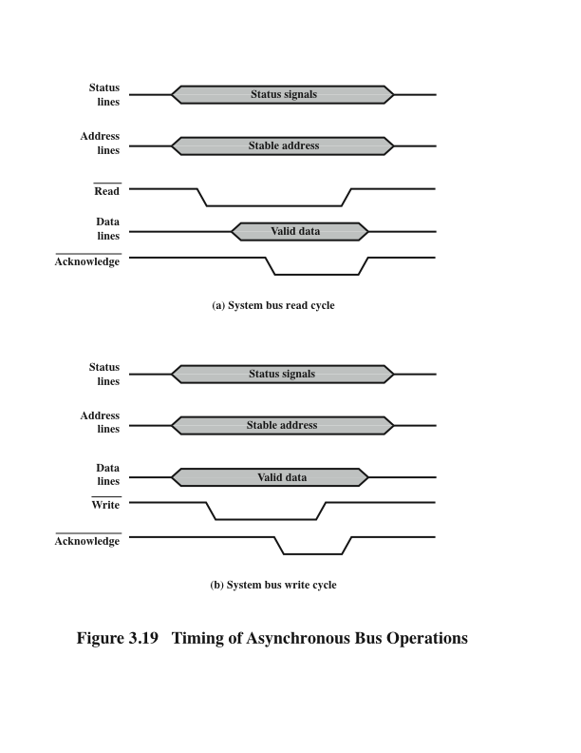
Timing of Asynchronous Bus Operations
Notes:
With asynchronous timing, the occurrence of one event on a bus follows
and depends on the occurrence of a previous event. In the simple read example of
Figure 3.19a,
The processor places address and status signals on the bus.
After pausing for these signals to stabilize, it issues a read command, indicating the presence of valid address and control signals.
The appropriate memory decodes the address and responds by placing the data on the data line.
Once the data lines have stabilized, the memory module asserts the acknowledged line to signal the processor that the
data are available.
Once the master(processor or IO) has read the data from the data lines, it deasserts the read signal.
This causes the memory module to drop the data and acknowledge lines.
Finally, once the acknowledge line is dropped, the master removes the address information.
Figure 3.19b shows a simple asynchronous write operation. In this case, the
master places the data on the data line at the same time that it puts signals on the
status and address lines. The memory module responds to the write command by
copying the data from the data lines and then asserting the acknowledge line. The
master then drops the write signal and the memory module drops the acknowledge
signal.
Synchronous timing is simpler to implement and test. However, it is less
flexible than asynchronous timing. Because all devices on a synchronous bus are
tied to a fixed clock rate, the system cannot take advantage of advances in device
performance. With asynchronous timing, a mixture of slow and fast devices, using
older and newer technology, can share a bus.

Slide 15
Synchronous VS Asynchronous
Synchronous timing is simpler to implement and test.
Less flexible than asynchronous timing.
Because all devices on a synchronous bus are tied to a fixed clock rate, the system cannot take advantage of advances in device performance.
With asynchronous timing, a mixture of slow and fast devices, using older and newer technology, can share a bus.

